Slide 1

Status of the Airline Industry
DSC 640 Term Project Milestone 2
Jonathon Scroggins

Slide 2
Fatal Accident Statistics
Airline Industry Vs. Auto Industry

Slide 3
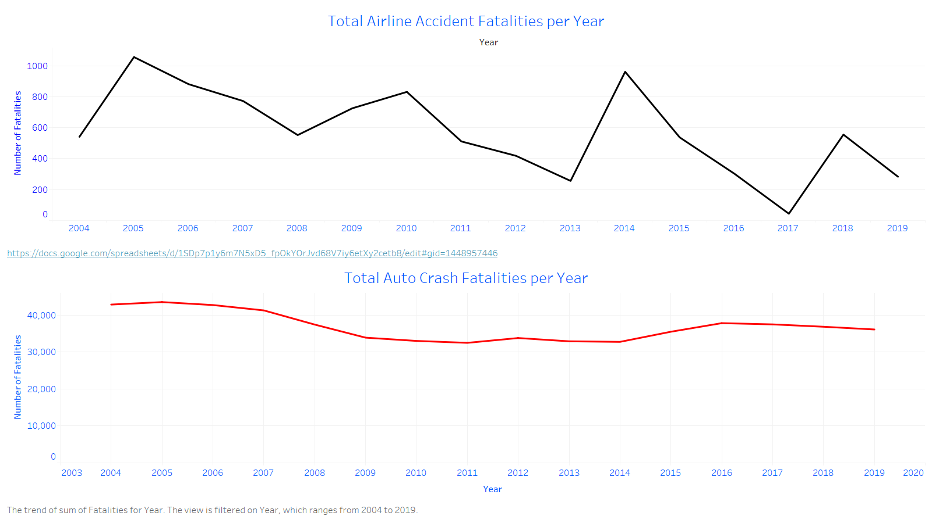
Per Year
10k fewer fatalities by airplane than by auto

Slide 4
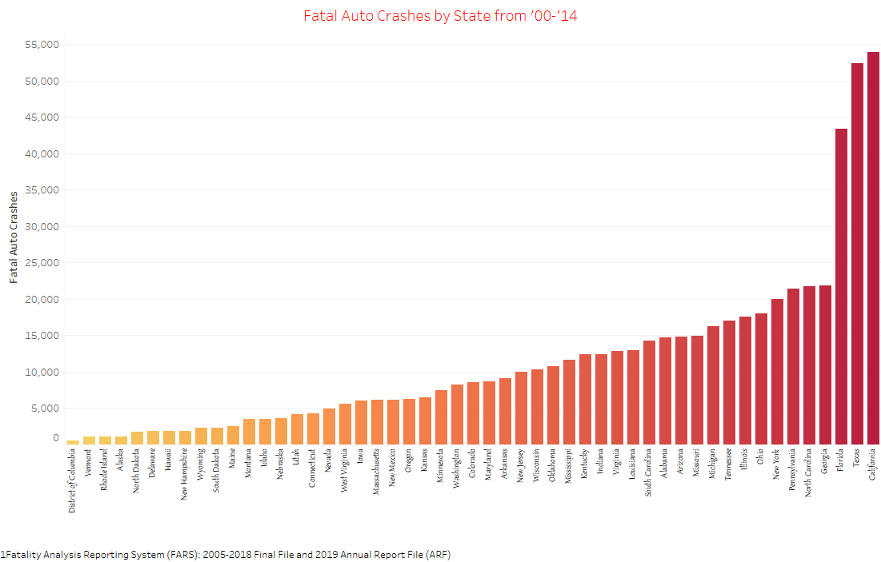
Per State

Slide 5
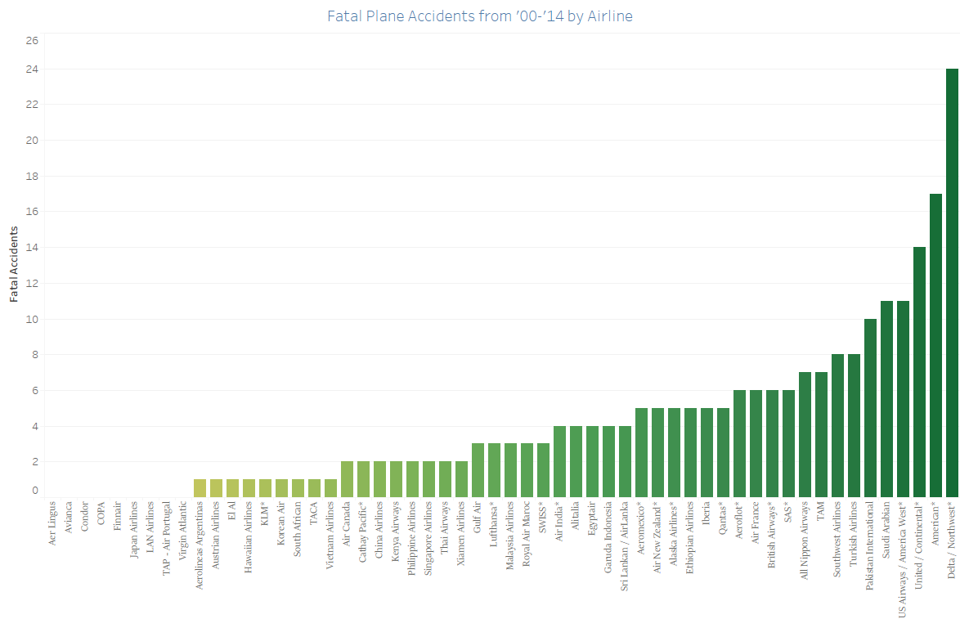
Per Airline

Slide 6
Airline Industry Revenue Statistics

Slide 7
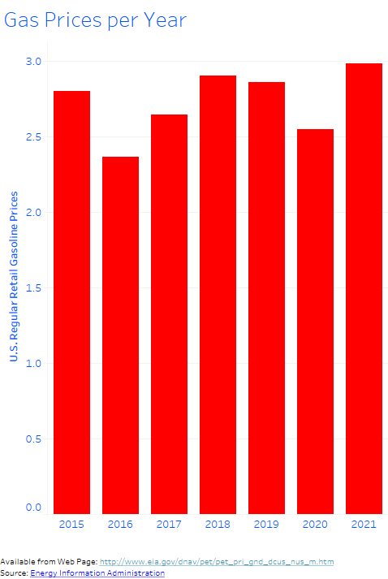
Auto Gas Prices
Gas prices continue to fluctuate, are not consistent and are going up, upsetting travelers.

Slide 8
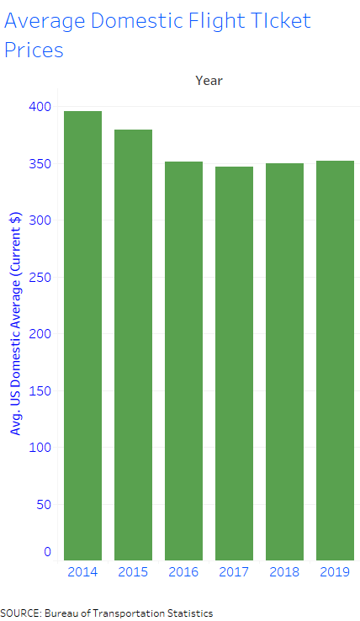
Airline Ticket Prices
Airline Ticket prices are remaining steady and have gone down in recent years, pleasing customers.

Slide 9
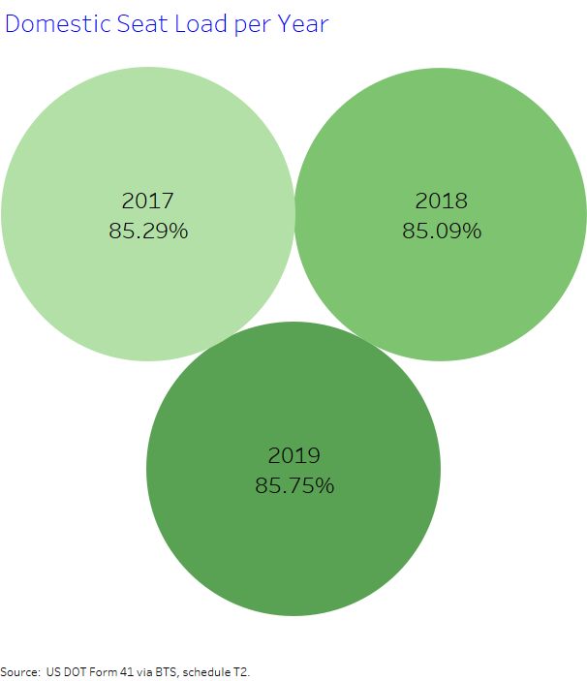
Percentage of Filled Seats per Plane
People are continuing to fly, based on the percentage of filled seats.

Slide 10
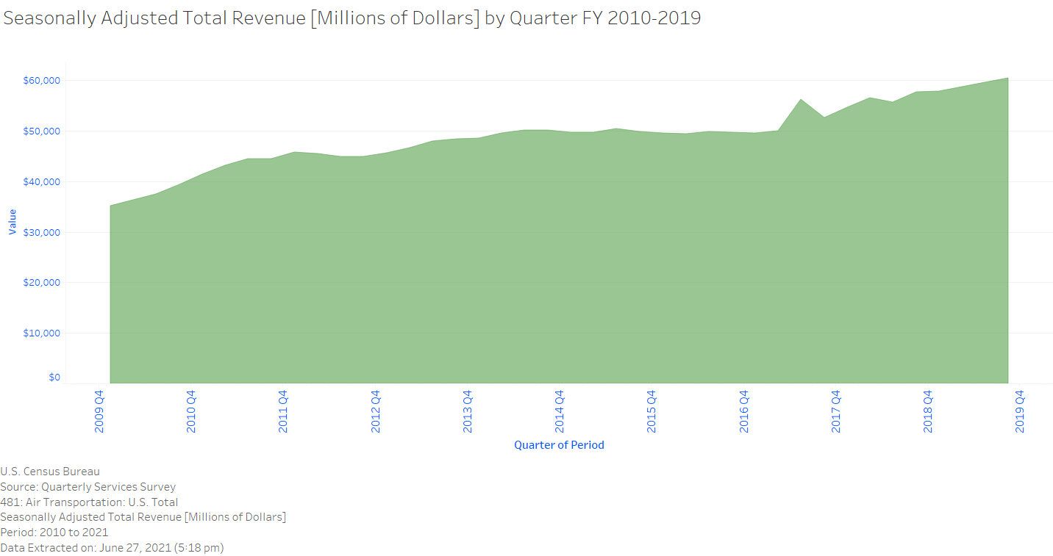
Revenue Steadily Increasing per Year

